Slide 1
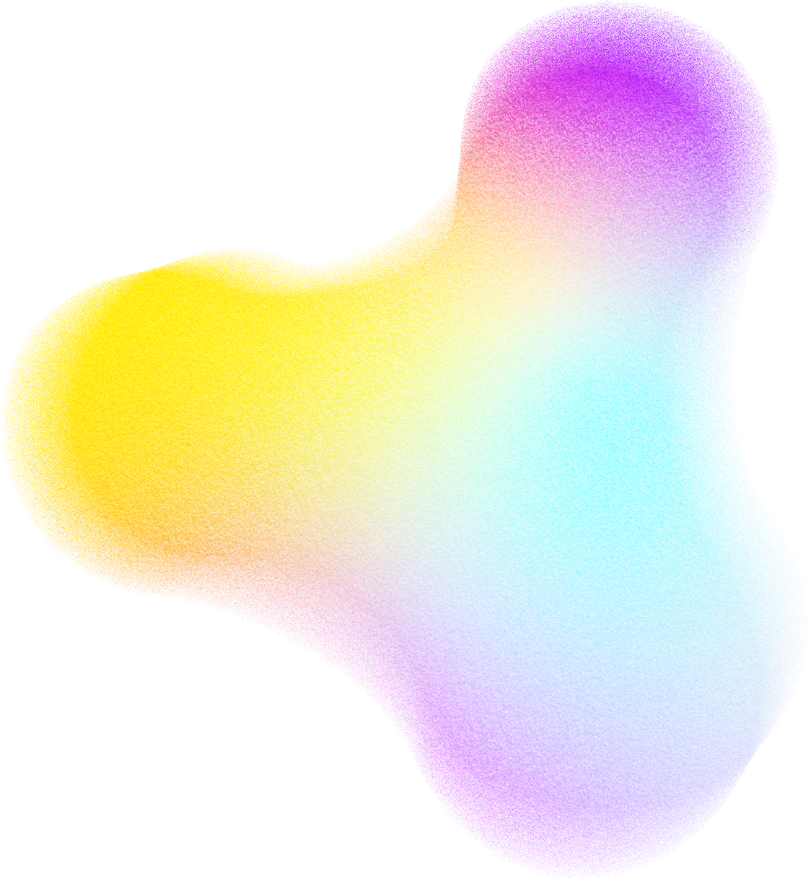



Damascus University
Faculty of Information technology
Quran AI Chatbot
Bilingual RAG-Based Assistant for Quranic Verses
Supervision by
Phd.Wesam Al-nabki
Presentated by
Essa Rastanawi
Muhammed yousef

Slide 2

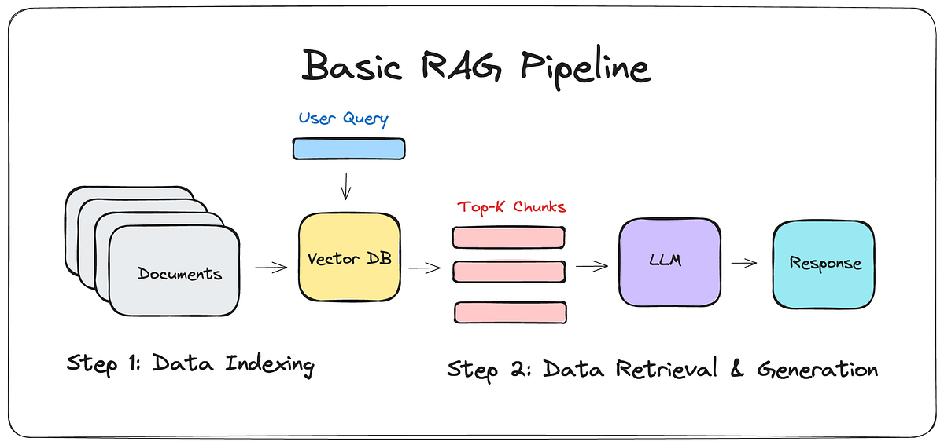

RAG Architecture
Page 00

Slide 3
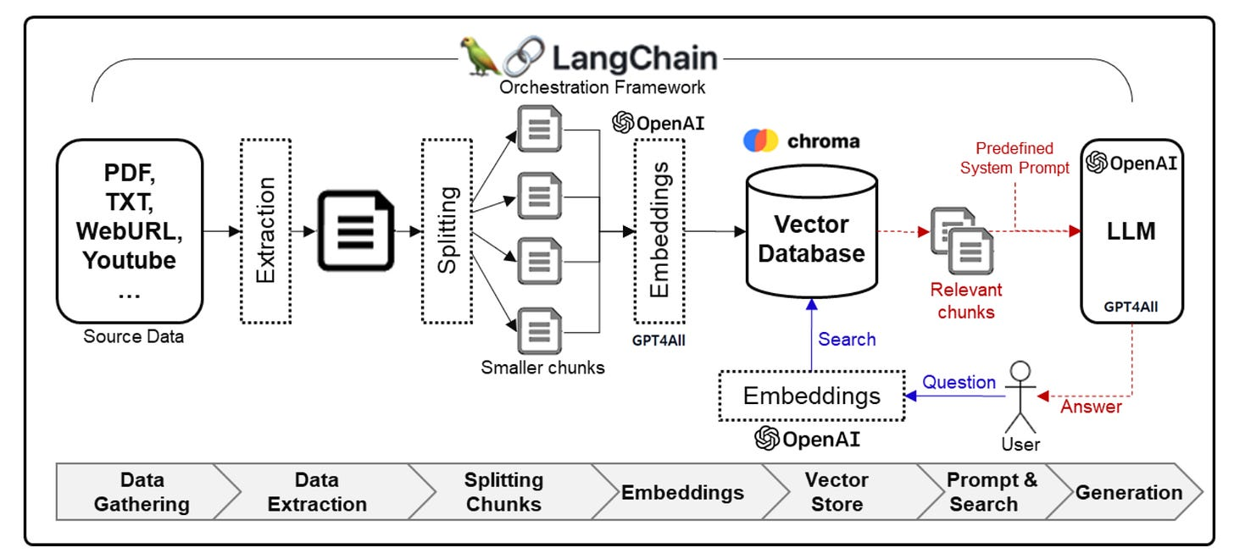

Project Architecture
Understanding Retrieval-Augmented Generation (RAG) With LangChain
Ranked Results
Page 01
Src:
Home – Documentation by LangChain
Prompt Engineering | Kaggle

Slide 4


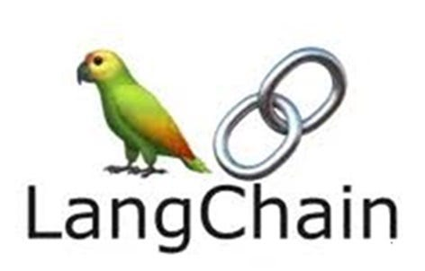



TOOLS TO IMPLEMENT RAG?
LangChain
ChromaDB
Streamlit
"A framework that organizes all
parts of an AI project (RAG, LLMs, Embeddings, Vector DB) and makes them work together easily."
Reactive UI framework for rapid deployment of interactive and responsive AI applications.
High-performance vector storage optimized for local similarity searches and metadata filtering.
Page 02

Slide 5


Data Preparation Pipeline
Source Integration: Utilizing verified Sahih International (English) and Tanzil (Arabic) corpora.
Semantic Chunking: Verses are indexed as individual units to maintain divine context.
Metadata Enrichment: Each vector is tagged with Surah name, Ayah number, and Revelation type.
Bilingual Mapping: Ensuring 1:1 alignment between Arabic script and English meanings.
Page 03

Slide 6


Semantic Mapping
Our vector database creates high-dimensional embeddings for all 6,236 verses of the Quran.
1-This allows the chatbot to perform semantic searches that transcend keyword matching
2-capturing the underlying essence of user queries in both Arabic and English.
6,236
Indexed Verses
Page 04

Slide 7

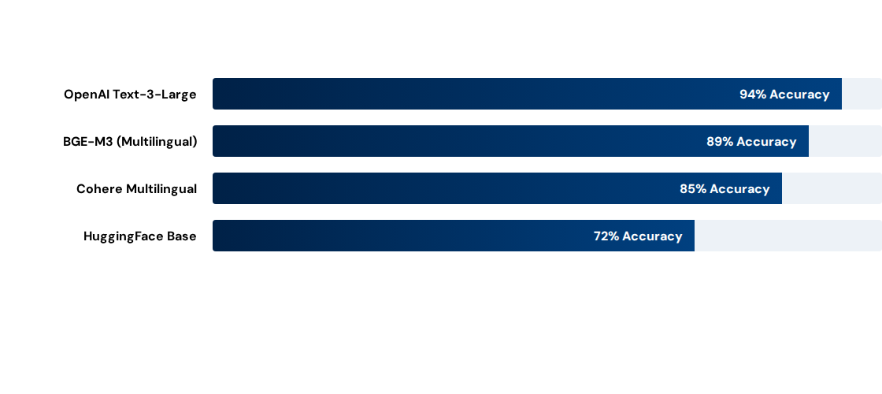
Embedding Model Benchmarks
Evaluation based on semantic retrieval precision for classical Arabic verses.6
Page 05
Src:
BGE-M3 SRC

Slide 8

Large Language Model Selection
GPT-4o (OpenAI)
Strengths: Superior reasoning, native-level multilingual fluency, and sophisticated context handling.
Trade-off: Recurring API costs and dependency on external cloud infrastructure.
Page 06

Slide 9
System Capabilities & Strengths
Verifiable Citations: Every AI response is strictly tied to retrieved context, providing Surah and Ayah numbers for transparency.
Bilingual Synthesis: Seamlessly handles queries in English or Arabic, providing translated responses with original script.
Hallucination Mitigation: RAG architecture ensures the model relies on the provided Quranic data rather than pre-trained "knowledge."
Real-time Inference: Optimized vector search allows for sub-second retrieval from the 6,236 verse index.
Page 08

Slide 10
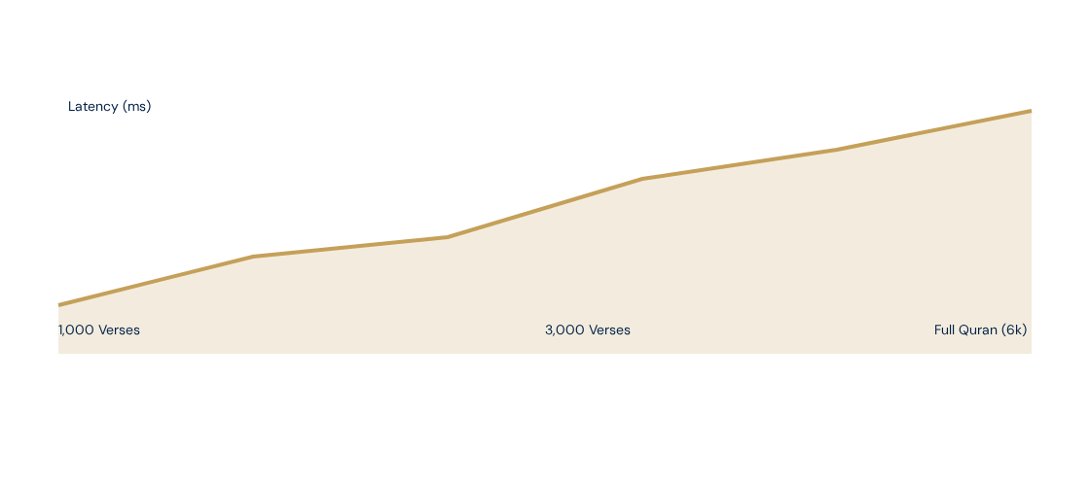
Retrieval Latency Optimization
Efficiency remains high even with full dataset indexing, averaging 50ms per retrieval step.
Page 09

Slide 11


Any Questions?

